Slide 1

AI-Powered Student Project Tracking & Management System
SOA Project Review-2
22-09-2026 / 1:20
Team Members
 | Under the Guidance of Dr. Neelima Gogineni Professor, Department of Computer Science and Engineering, KLH CSE Bowrampet Campus
Name | Roll Number
Kommineni Rahul | 2420030011
Pathi Sharmila | 2420030042
Ivaturi Vennela | 2420030185

Slide 2
Project Design
User & Role Management – Manage Admin, Mentor, and Student accounts with role-based access and permissions.
Project Management – Create and manage projects, milestones, epics, stories, and project progress.
Task & Sprint Management – Organize tasks into sprints, track deadlines, priorities, workload, and completion status.
Submission & Evaluation – Enable students to submit deliverables and mentors to review, evaluate, and provide feedback.
AI-Powered Monitoring – Analyze project progress, task status, and deadlines to identify pending, overdue, and at-risk tasks.
Intelligent Recommendations – Prioritize tasks and recommend the next best action based on project status and deadlines.
Notifications & Reporting – Generate deadline alerts, risk notifications, progress reports, and AI-based project insights.
SOA/Microservices Architecture – Implement independent services for modularity, scalability, maintainability, and efficient integration.

Slide 3
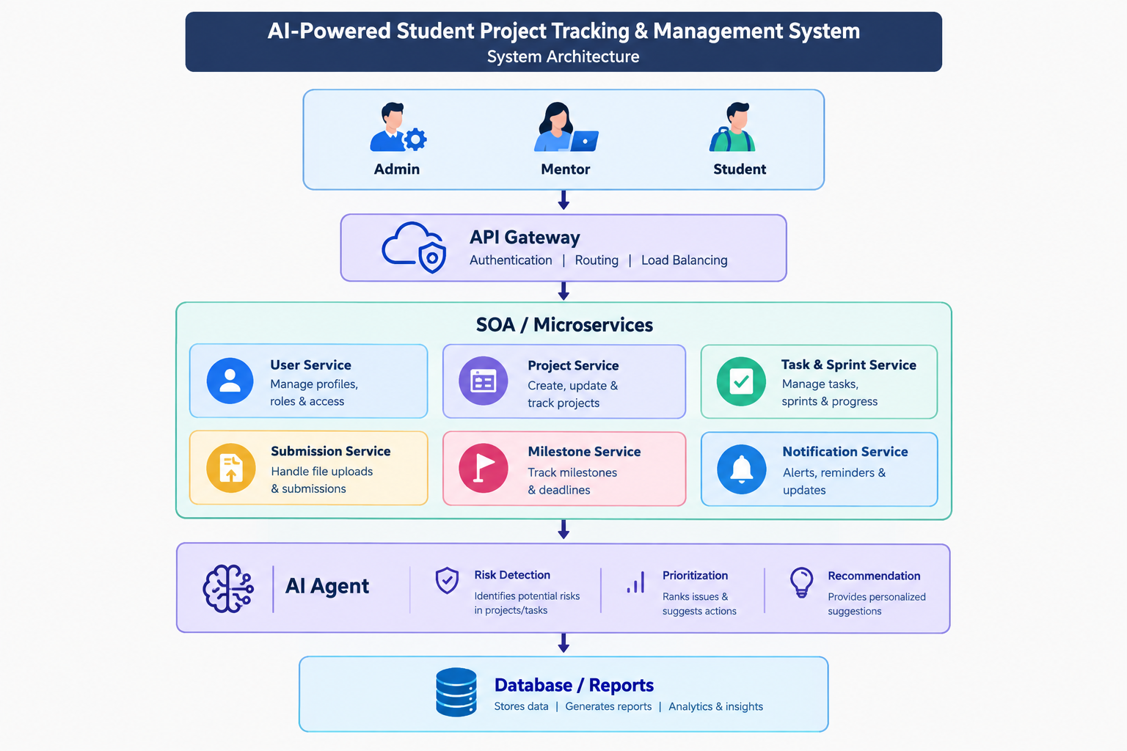
System Architecture

Slide 4
Methodology
Requirement Analysis – Identify Admin, Mentor, and Student requirements for project tracking, submissions, monitoring, and AI features.
Role-Based Design – Design separate interfaces and permissions using RBAC.
Project & Sprint Setup – Create projects with epics, stories, tasks, milestones, sprints, and deadlines.
Task & Progress Tracking – Monitor task assignments, priorities, workload, completion, and sprint progress.
Submission & Evaluation – Enable student submissions and mentor review, evaluation, and status tracking.
AI-Based Project Analysis – Use the AI Risk Radar to detect overdue and at-risk tasks based on project data.
Intelligent Decision Support – Provide priority suggestions, risk insights, and next-action recommendations.
Integration & Evaluation – Integrate services using SOA/Microservices and evaluate workflows, AI features, and risk management.

Slide 5




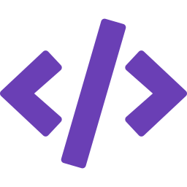



Methodology Adopted – 7-Phase Engineering Lifecycle
1. Requirement Analysis
2. System & SOA Design
3. Database & Schema Design
4. Core Full-Stack Development
5. AI Copilot & Risk Engine
6. Testing & Quality Assurance
7. Deployment & Documentation
Survey capstone pain points; align with ABET & university viva rubrics.
API Gateway, decoupled domain services, Circuit Breakers & SSE sync.
Model Projects, Sprints, Tasks, Directives, Rubrics & Audit Logs.
React 19 + TypeScript frontend; Node.js/Express REST microservices.
Gemini API + fallback heuristics for WBS and risk intelligence.
UI tests, API contracts, RBAC validation & circuit breaker tests.
Containerized setup, offline fallback caches & viva defense reports.

Slide 6
Technical Soundness
Frontend: React 19 + TypeScript + Vite + Tailwind CSS provide a responsive, component-based interface for Admin, Mentor, and Student dashboards, with Lucide Icons and DnD Kanban for task management.
Backend: Node.js + Express.js + TypeScript implement the backend services using REST Microservices. SSE Event Bus supports real-time updates for task progress, submissions, notifications, and AI insights.
Database: TiDB / MySQL relational cloud database provides structured and scalable storage for users, projects, tasks, sprints, submissions, milestones, and AI-generated insights, with high-availability in-memory processing for efficient access.
Overall Architecture: The technologies support a modular, scalable, real-time SOA/Microservices system suitable for the AI-powered student project tracking platform.

Slide 7









Technical Soundness
Production Technology Stack
Multi-Tier Architecture & Data Flow
Frontend
React 19, TypeScript, Vite, Tailwind CSS, Lucide Icons, DnD Kanban
Backend
Node.js, Express.js, TypeScript, REST Microservices, SSE Event Bus
1. Client Tier
Role-aware UI
Student • Mentor • Admin
2. Gateway Tier
JWT validation • RBAC • routing
3. Service Tier
Sprint planning • rollover • rubric scoring
Security & Resilience
Circuit Breakers, Rate Limiting, Helmet, JWT & RBAC
Database
TiDB / MySQL relational cloud database + high-availability in-memory engine
5. Event & Persistence
Relational DB + SSE live updates
4. Fault Tolerance
Circuit breakers + in-memory fallback
AI ENGINE
Google Gemini API + Hybrid Heuristic Rule Engine

Slide 8
Implementation
Module 1 – User & Role Management
Handles Admin, Mentor, and Student accounts, authentication, role-based permissions, and user/project assignments.
Module 2 – Project Management
Enables project creation and management, including project details, team members, mentors, milestones, and project status.
Module 3 – Sprint & Task Management
Manages epics, stories, sprints, and tasks, including task assignment, priority, deadlines, status, and workload.
Module 4 – Submission & Evaluation
Allows students to submit project deliverables and mentors to review submissions, provide feedback, and record evaluation results.

Slide 9
Module 5 – Progress Monitoring
Tracks task completion, sprint progress, milestones, pending work, and overall project progress to provide a current project status.
Module 6 – AI Risk Analysis
The AI Risk Radar analyzes project progress, task status, deadlines, and workload to identify overdue, delayed, and at-risk tasks/projects.
Module 7 – AI Task Recommendation
The AI Agent analyzes pending work and deadlines to prioritize tasks and recommend the next best action for improving project progress.
Module 8 – Notification & Reporting
Generates deadline alerts, risk notifications, project progress reports, and AI-generated project insights for relevant users.
Module 9 – SOA/Microservices Integration
Implements the system as independent services connected through APIs, enabling modular development, service-level communication, scalability, and easier maintenance.

Slide 10
THANK YOU

